Slide 1
How to install MikTeX and TeXstudio in Windows
David Raj Micheal

Slide 2
What is this document about..
This document gives the step by step procedure to install miktex and texstudio which are essential to prepare LaTeX documents.
This material does not include the installation process for other operating systems such as linux, Ubuntu or mac.
For other platforms, the following softwares can be installed in the miktex and tex studio.
Operating system | Back end (compiler) | Front end
Linux, ubuntu | Texlive (How to install) | TexStudio
Mac | MacTex (How to install) | Tex studio

Slide 3
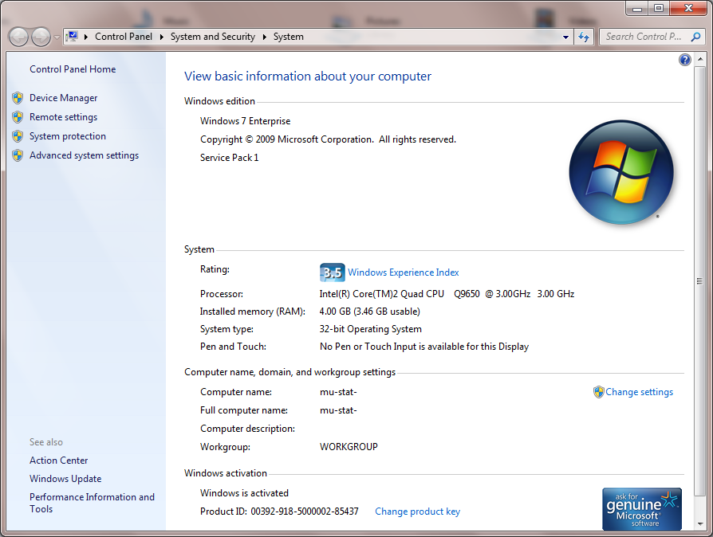
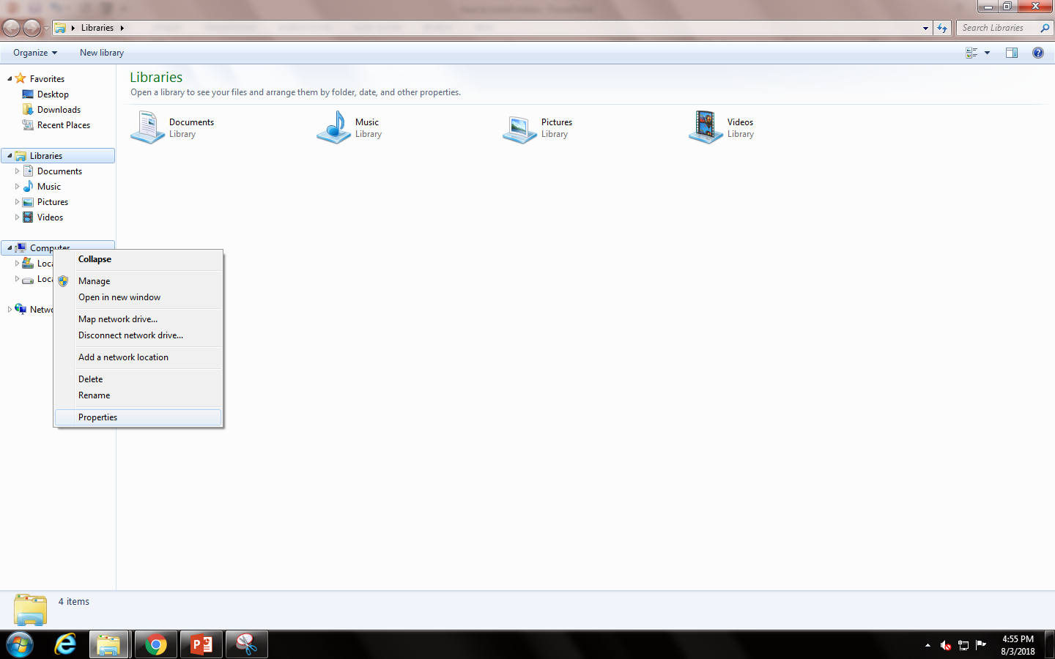
Knowing your computer.
Right click on computer and click on properties.
Note down your system’s bit.
Here in my case its 32bit.

Slide 4
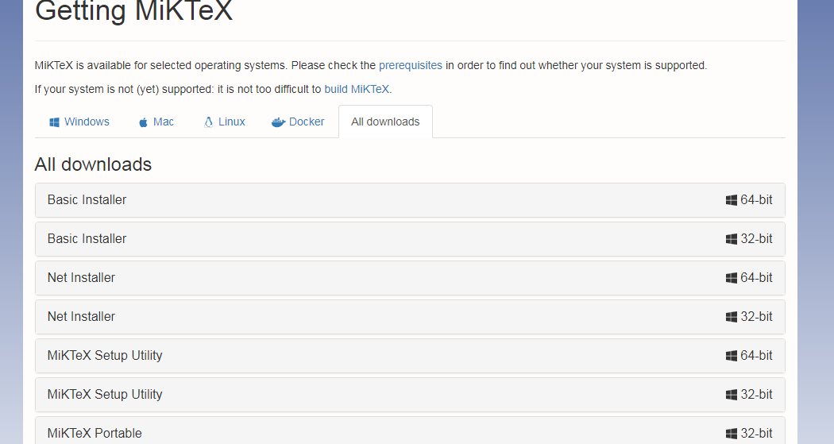
How to install MikteX…
Go to https://miktex.org/download
Go to all downloads.
Download your basic installer.
In my case, I am downloading 32 bit version since I am in 32bit machine.
Save your download in your computer at your choice

Slide 5
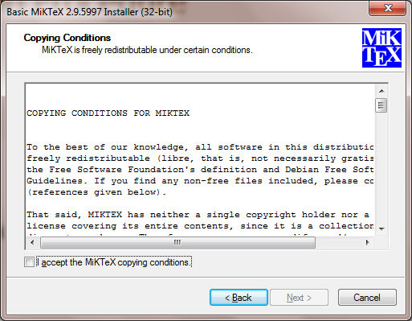
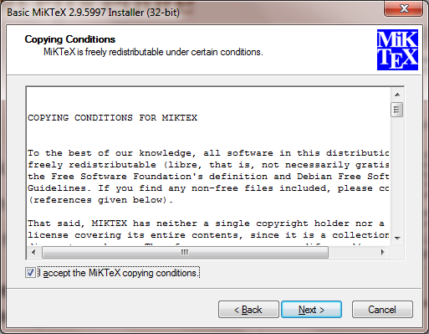
Installation Procedure
Double click on the downloaded file
Click ‘yes’ in the dialog box appears.
Then in the next dialog box click on “I accept the MiKTeX copying conditions and proceed next.

Slide 6
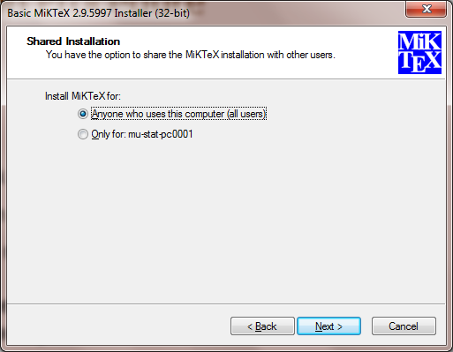
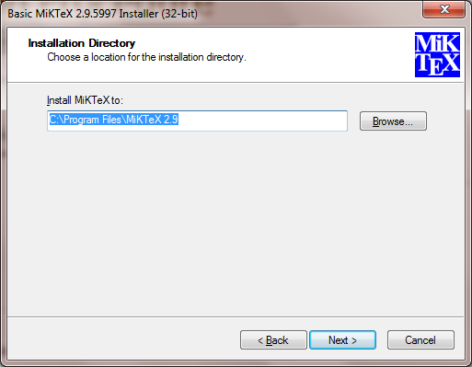
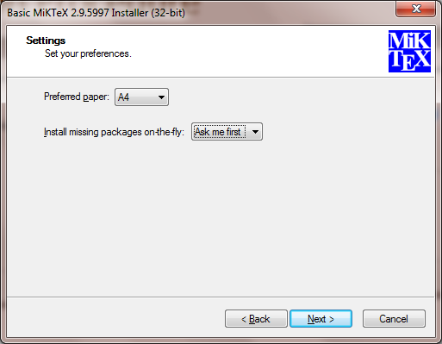
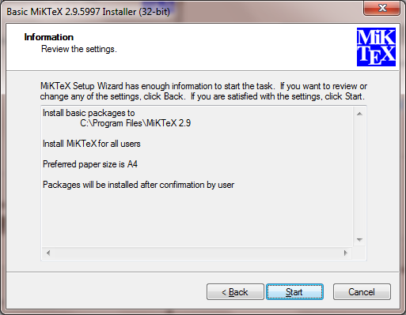

Slide 7
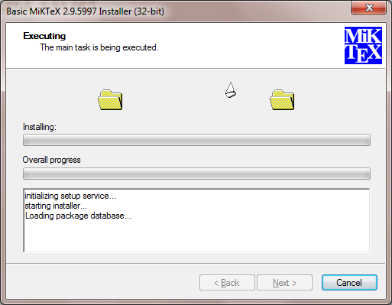
After clicking `start’ it will start the installation process.
Click finish at the end after the installation.
That’s it. MikTeX installation is over.
Lets move on to install a front end editor ‘TeX studio’

Slide 8
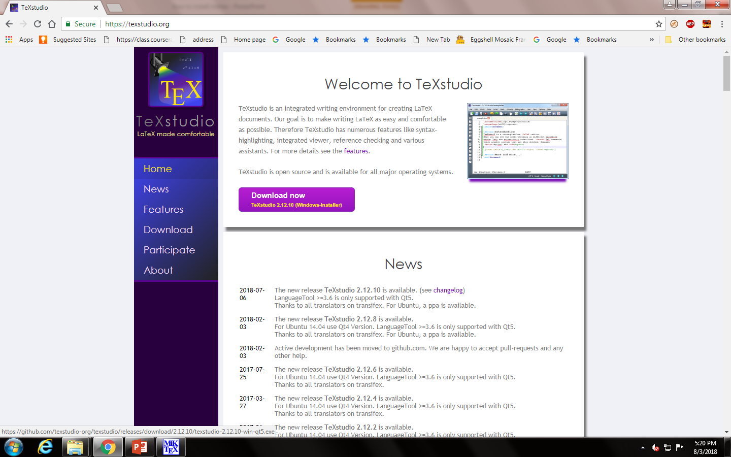
Installing TeXstudio
Go to the website http://texstudio.org/
Click on Download now
Save your file in your computer.

Slide 9
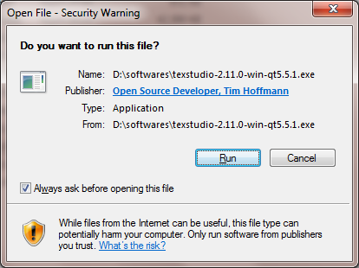
Installing TeXstudio
Double click on the file you have downloaded now.
Click Run
Cick ‘yes’ in the next dialog box appears.

Slide 10
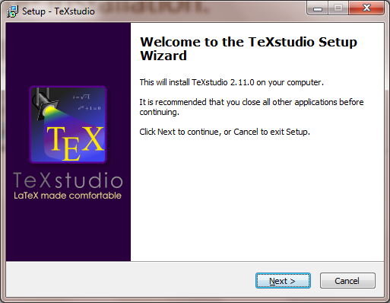
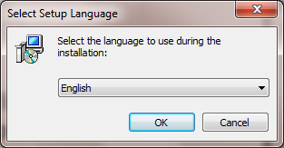
Proceed the installation.

Slide 11
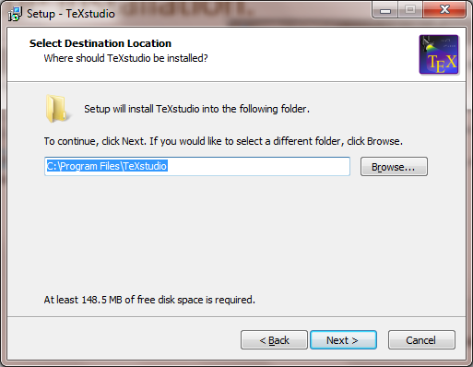
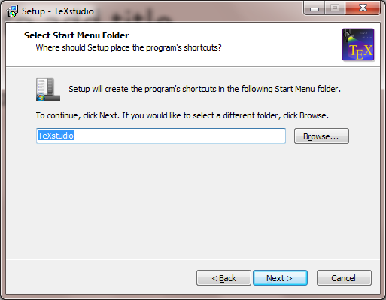

Slide 12
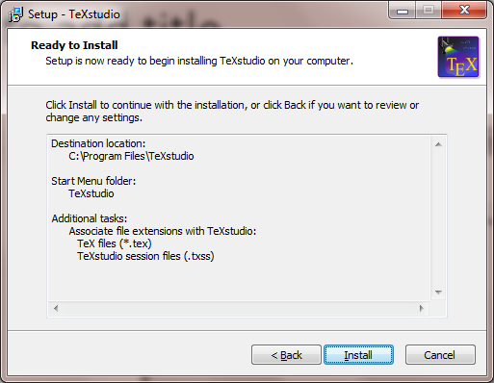
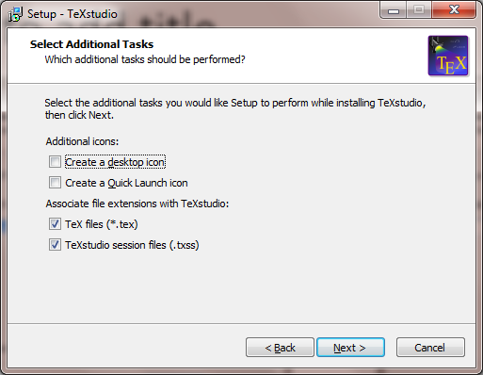

Slide 13
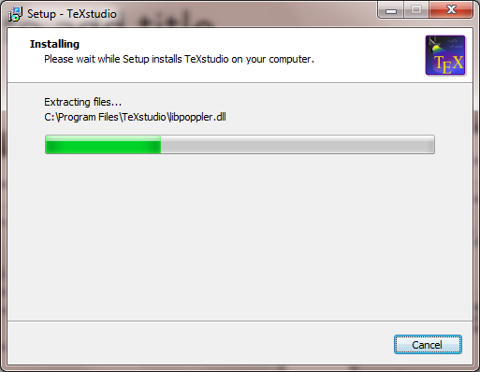
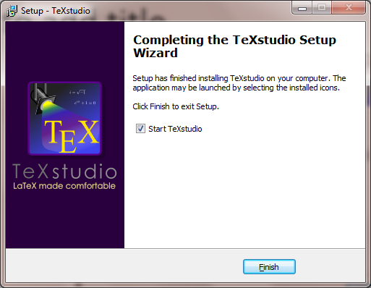

Slide 14


